Slide 1
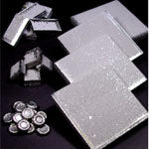
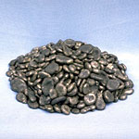
↓ﾌｪﾛﾆｯｹﾙ
( Fe-Ni)
↑電気ﾆｯｹﾙ
( E-Ni)
Notes:
This is the picture of E-Ni. We are producing various grades and various form of E-Ni which satisfies the customers demand. I am going to explain it later.

Slide 2
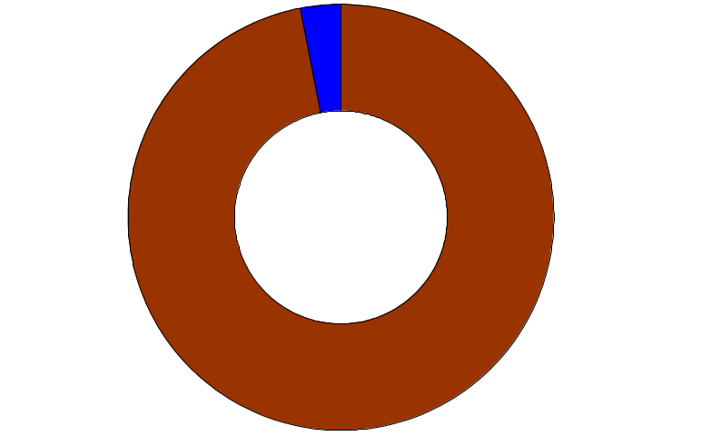
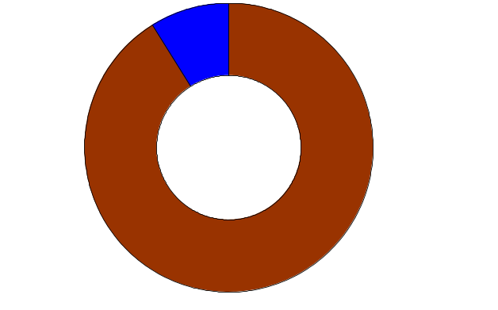
Japanese Nickel Consumption (2003)
Plating
15%
Stainless
Plating
Steel
7%
E-Ni
25%
Alloy
92 KMt
IT
Related
Total
Stainless
IT Related
192 KMt
Steel
60%
IT
3%
32%
IT
9%
61%
Battery
NOS
28 KMt
Fe Ni
72KMt
Stainless
Steel 91%
Stainless
Steel 97%
Notes:
This shows the same thing as the previous presentation.
E-Ni is mainly used for IT related products such as alloy and battery. It is also used for plating and stainless steel.
Ferronickel and Nickel Oxide Sinter is mainly used for stainless steel.

Slide 3
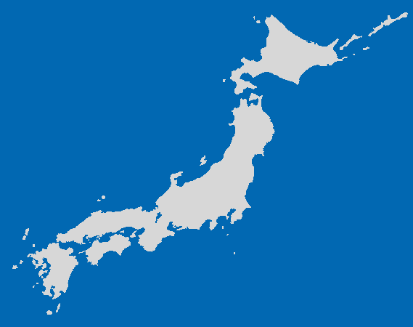
Location of the Refinery and Smelter
Hyuga Smelter
Fe Ni
Hyuga City, Miyazaki Pref.
Tokyo
(Head Office)
NNR
(Niihama Ni Refinery)
E-Ni
Ni Salts
Niihama City, Ehime Pref.
Notes:
This map shows the location of the plants.
Now, you are in our Tokyo Head Office.
Niihama Nickel Refinery is located in Shikoku Island.
Hyuga Nickel Smelter is located in Kyusyu Island. It is the southern part of Japan.

Slide 4
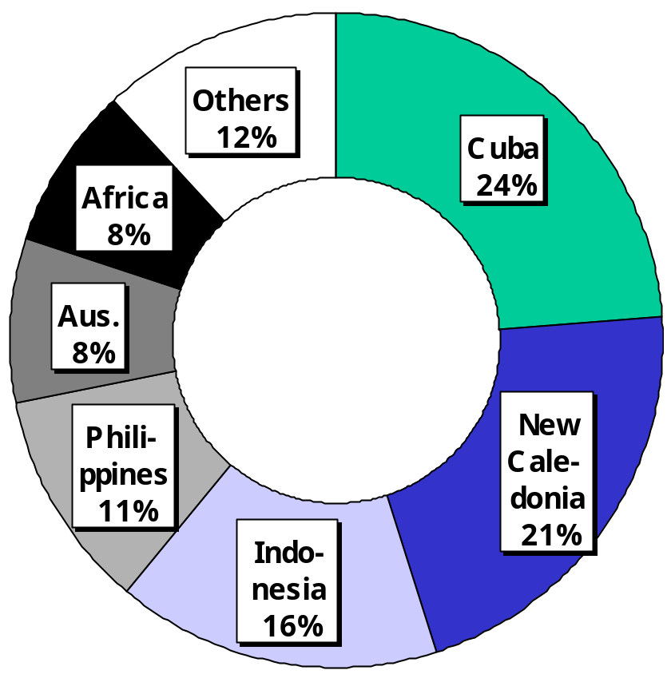
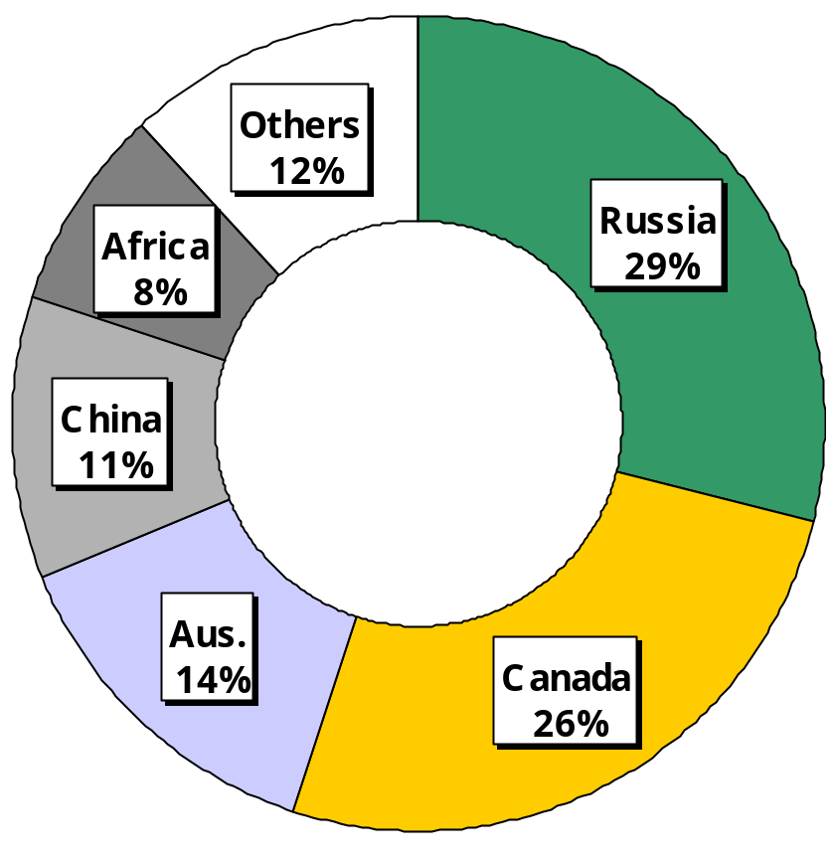
Ni Resources in the World (2000)
Ni Oxide
140 Mil. t
Ni Sulfide
62 Mil. t
64% of nickel products (metal) is refined from sulfide ore
Notes:
Before going to main subject, I’d like to touch Ni resources all over the world.
This slide shows amount of Ni oxide and sulfide ores, respectively.
In terms of total resource, oxide is over twice as much as sulfide.
Cuba has the largest nickel oxide deposits.
In addition, you can see the large oxide deposits are around west-south side of pacific ocean, such as New Caledonia, Indonesia….
Speaking of sulfide ore, in Russia there are a lot of deposits.
So far, 64% of nickel products is

Slide 5
Nickel refine process
Ore
Products
Sulfide
Matte(Pyro)
Cl2 Leach
Electrowinning
Electro. Ni
Falcon
SMM
OMG
Impala
Inco
Norilsk
WMC
Inco
H2SO4Leach
Electrowinning
Electro. Ni
Ni powder
H2 Reduction
Ni briquette
Electrorefine
Electro. Ni
Roasting
Reduction
Smelting
Electrorefine
Electro. Ni
NH3 Leach
H2 Reduction
Ni briquette
Ni powder
Roasting
Vaporizing
refining
Ni powder
Pellet

Slide 6
Nickel refine process
Ore
Products
Oxide
Matte(Pyro)
Cl2 Leach
Electrowinning
Electro. Ni
SMM
Moa Bay
Murrin2
Cawse
Sered
Nicaro
SMM
PAMCO
HPAL
Sulfurization
Purification
Ni powder
Etc.
H2 Reduction
Roasting
NH3 Leach
Electrowinning
Electro. Ni
Roasting
NiO
Roasting
Smelting
Fe-Ni

Slide 7
Nickel Sulfide Refining Process
Final
Product
Ore
Mine
採鉱
Mill
選鉱
Smelter
熔錬
Refinery
精製
Ni ore Ni conc. Ni Matte Ni Metal
1~2% ~30% 50％~80% >99.9%

Slide 8
Nickel Oxide Refining Process
Oxide Ore
Final
Product
Mine
採鉱
HPAL
高圧硫酸浸出
Refinery
精製
Ni ore Ni Intermediate Ni Metal
1~2% 50％~60% >99.9%

Slide 9
Flowsheet of MCLE
Matte / MS ; Ni, S, Cu, Co, Fe
Chlorine Leach
S as Residue
Ni, Cu, Co, Fe as ions in liq.
Cementation
Cu as Cu sulfide
Ni, Co, Fe as ions in liq.
Co/Fe Removal
Co,Fe,(Ni) as Hydroxide
Ni as NiCl2 in liq.
Electrolysis
MCLE : Matte Chlorine
Leach Electrowinning
E-Ni
Notes:
This shows the flowsheet of MCLE which Mr.Matsumoto explained in the morning session.

Slide 10
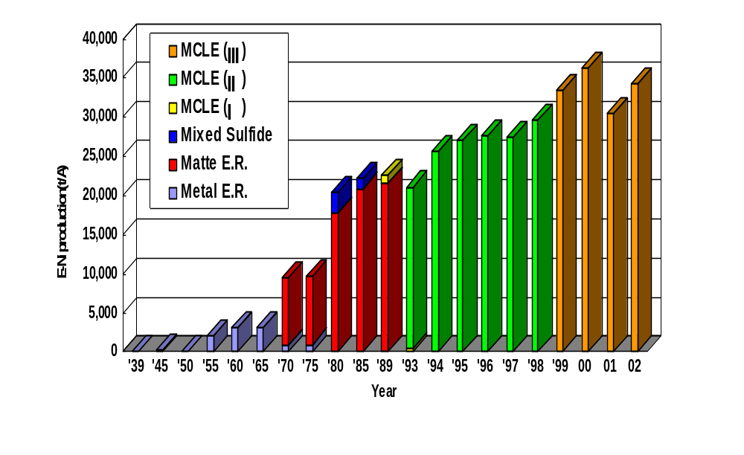
Electro-Nickel (E-Ni) Production
MCLE： Matte Chlorine Leach Electrowinning
Notes:
This shows the history of production rate of E-Ni at Niihama Nickel refinery.
ince the commissioning, we have satisfactorily increased our production with changing the production process.
Currently, we have established chlorine leach process for nickel sulfide and named MCLE.
The MCLE technology is superior in recovery of nickel and operability.
Our current production by this process is more than 30,000 t and we maintain a stable production.

Slide 11
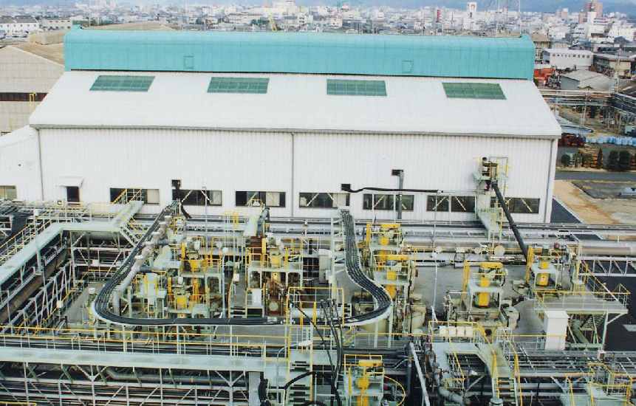
Purification Stage of MCLE

Slide 12
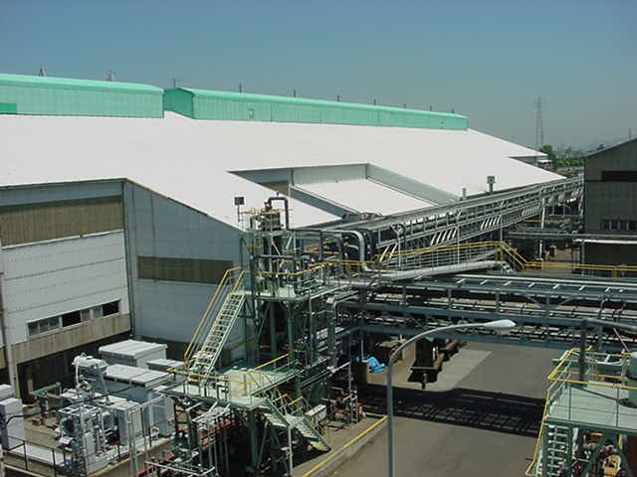
Tank House(outside)

Slide 13
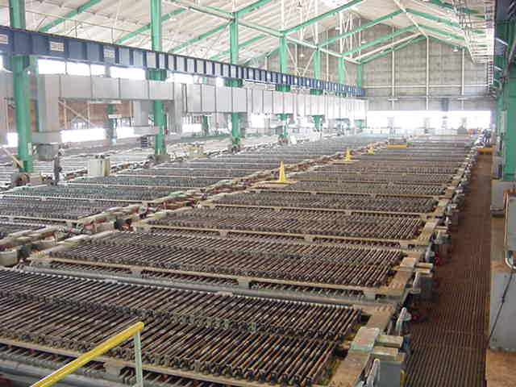
Tank House(inside)

Slide 14
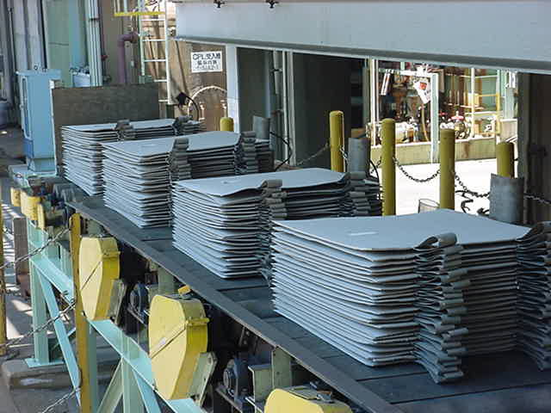
Nickel Cathodes

Slide 15
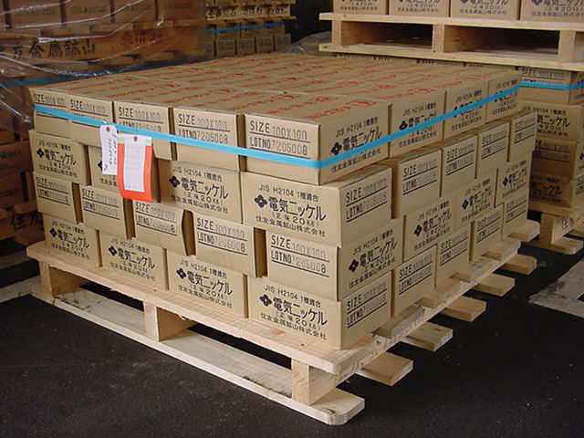
Carton Box (1×1)

Slide 16
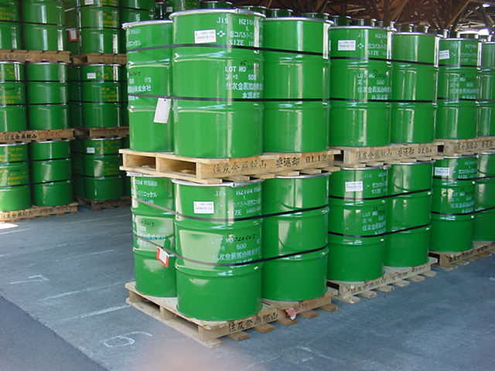
Drams (4×4)

Slide 17
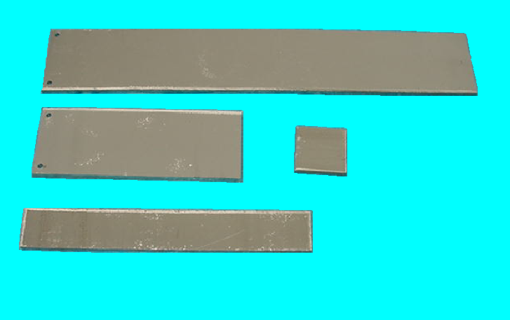
Electrolytic Nickel
4 inch

Slide 18
Feasibility Studies for implementation of HPAL
Environment & Safety
Geology & mine planning
Process results
Ore geometallurgy
Geotechnical data
Engineering parameters
Process
Model
Commercial & Strategy
Synergies w/, other projects
Model output
Capex, Opex
parameters
Metallurgical
& Engineering
Testwork
Optimization
Economic
Model
Maximizing
Profitability
Minimizing Risks
Optimized Project Concept

